Slide 1
Reading Group
Network Coding for Distributed Storage Systems
IEEE TRANSACTIONS ON INFORMA TION THEORY 2010
2021/10/11
Presenter: Tianyang Niu

Slide 2
Outline
1
Background
2
Motivation
3
Design
4
Evaluation
3
5
Conclusion

Slide 3
Outline
1
Background
2
Motivation
3
Design
4
Evaluation
3
5
Conclusion

Slide 4
Background
Distributed Storage Systems
Replication
Erasure codes

Slide 5
Background
MDS
Maximum Distance Separable
Reed-Solomon codes
redundancy-reliability tradeoff
regenerating codes
redundancy, reliability, and repair-bandwidth tradeoff.

Slide 6
Background
Network Coding
allows information to be “mixed”

Slide 7
Outline
1
Background
2
Motivation
3
Design
4
Evaluation
3
5
Conclusion

Slide 8
Background
erasure code
generate encoded fragments transferring as little data
regenerating code

Slide 9
Motivation
MDS
M
(4,2)

Slide 10
Motivation
MDS
M
(4,2)

Slide 11
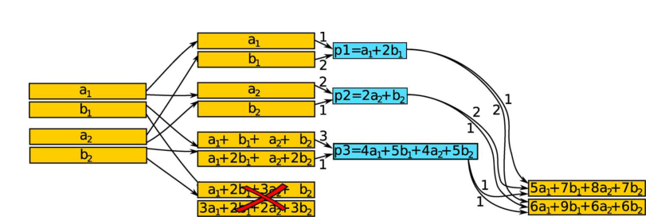
Motivation
Min
M(2MB)
1.5MB

Slide 12
Motivation

Slide 13
Outline
1
Background
2
Motivation
3
Design
4
Evaluation
3
5
Conclusion

Slide 14
Design

Slide 15
Outline
1
Background
2
Motivation
3
Design & Implementation
4
Evaluation
3
5
Conclusion

Slide 16
Evaluation
Environment
Amazon EC2 C5
Ubuntu 20.04
Linux kernel 5.4.41

Slide 17
Outline
1
Background
2
Motivation
3
Design
4
Evaluation
3
5
Conclusion

Slide 18
Conclution

Slide 19
THANK YOU

